Slide 1



SMART ANTI-BUNKING ATTENDANCE SYSTEM USING FACE RECOGNITION
Modernizing Academic Administration through Biometrics and Automated Communication
PROJECT BY
AISHWARYA. R
II - M.SC.COMPUTER SCIENCE
2413322078002

Slide 2


Abstract
MODERNIZING ADMINISTRATION: TRANSITIONING FROM MANUAL ROLL CALLS TO A HIGH-ACCURACY BIOMETRIC ECOSYSTEM.
REAL-TIME VERIFICATION: UTILIZING DEEP LEARNING ARCHITECTURES TO MAP FACIAL FEATURES AGAINST A MYSQL DATABASE.
CLOSING COMMUNICATION GAPS: INTEGRATING WHATSAPP NOTIFICATIONS FOR IMMEDIATE ABSENTEE ALERTS TO GUARDIANS.
FOSTERING DISCIPLINE: KEEPING PARENTS ACTIVELY ENGAGED IN THEIR WARD’S DAILY EDUCATIONAL JOURNEY.

Slide 3


System Specifications
HARDWARE SPECS
SOFTWARE SPECS
PROCESSOR: 13TH GEN INTEL CORE I5-1335U
RAM : 16.0 GB DEDICATED
CAMERA : 720P/1080P STANDARD WEBCAM
STORAGE : 933 GB CAPACITY
OS : WINDOWS 11
EDITOR : VISUAL STUDIO CODE
PROGRAMMING LANGUAGE : PYTHON 3.9+
FRONTEND FRAMEWORK : STREAMLIT
BACKEND DATABASE : MYSQL SERVER 8.0+
VIRTUAL ENVIRONMENT : ANACONDA OR STANDARD PYTHON VENV

Slide 4


Core Development Framework
Python (Core Engine)
Streamlit (The GUI)
Binds to low-level C++ libraries like OpenCV and dlib for high-performance facial landmark mapping. Dynamically handles massive memory arrays for real-time video processing.
Eliminates complex API routing by allowing pure Python frontend development. Natively manages Session States for strict Role-Based Access Control (RBAC).

Slide 5
Core Libraries And Modules
OpenCV
Face Recognition
NumPy
Handles complex matrix math and image data formatting.
Captures real-time 8-bit RGB video arrays from hardware.
Maps 128-d landmarks for biometric encodings via dlib.
PyWhatKit
MySQL Connector
Dlib
Automates instant WhatsApp absentee alerts to guardians.
Secure bridge for dynamic SQL execution and ledger updates.
Underlying engine for facial point estimation and detection.

Slide 6

Database Management: MySQL
Strict Data Integrity: Enforces Primary Keys to guarantee zero proxy entries or duplicate records.
High-Speed Querying: Optimized for millisecond read/write operations to prevent camera lag.
Direct Ledger Control: Utilizes Command Line Client for maximum security and execution speed.

Slide 7
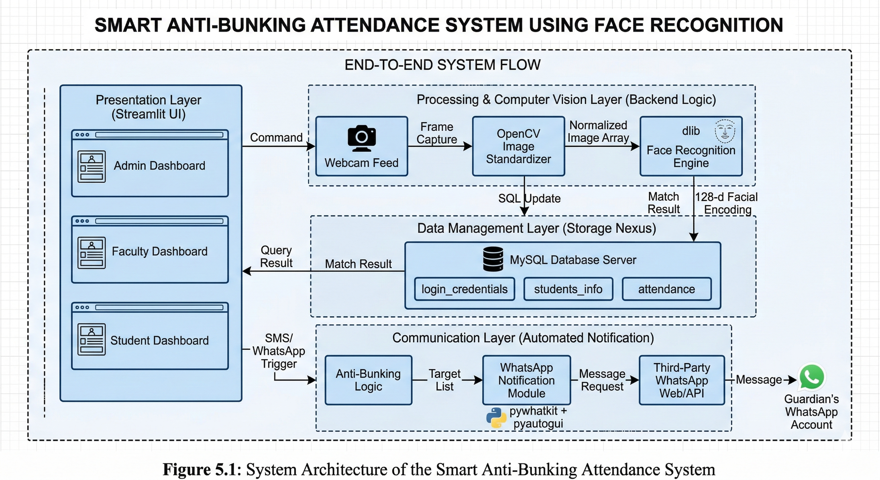
System Architecture
PRESENTATION LAYER: STREAMLIT RBAC GUI.
Computer Vision Layer: OpenCV Frame Capture + dlib Encoding.
Data Management Layer: MySQL Relational Database Server.
Communication Layer: Automated WhatsApp Alert Pipeline.

Slide 8



Project Description & Modules
MODULAR ARCHITECTURE: THE SYSTEM IS DIVIDED INTO THREE PRIMARY MODULES: ADMIN, FACULTY, AND STUDENT.
Role-Based Access Control (RBAC): Access is strictly governed via a centralized login portal authenticated against the MySQL database.
Operational Parity: Admin and Faculty dashboards are unified by design. This ensures Administrators can step in to mark attendance or manage sessions seamlessly during faculty absences, preventing systemic bottlenecks.
ADMIN DASHBOARD
FACULTY DASHBOARD
STUDENT DASHBOARD

Slide 9
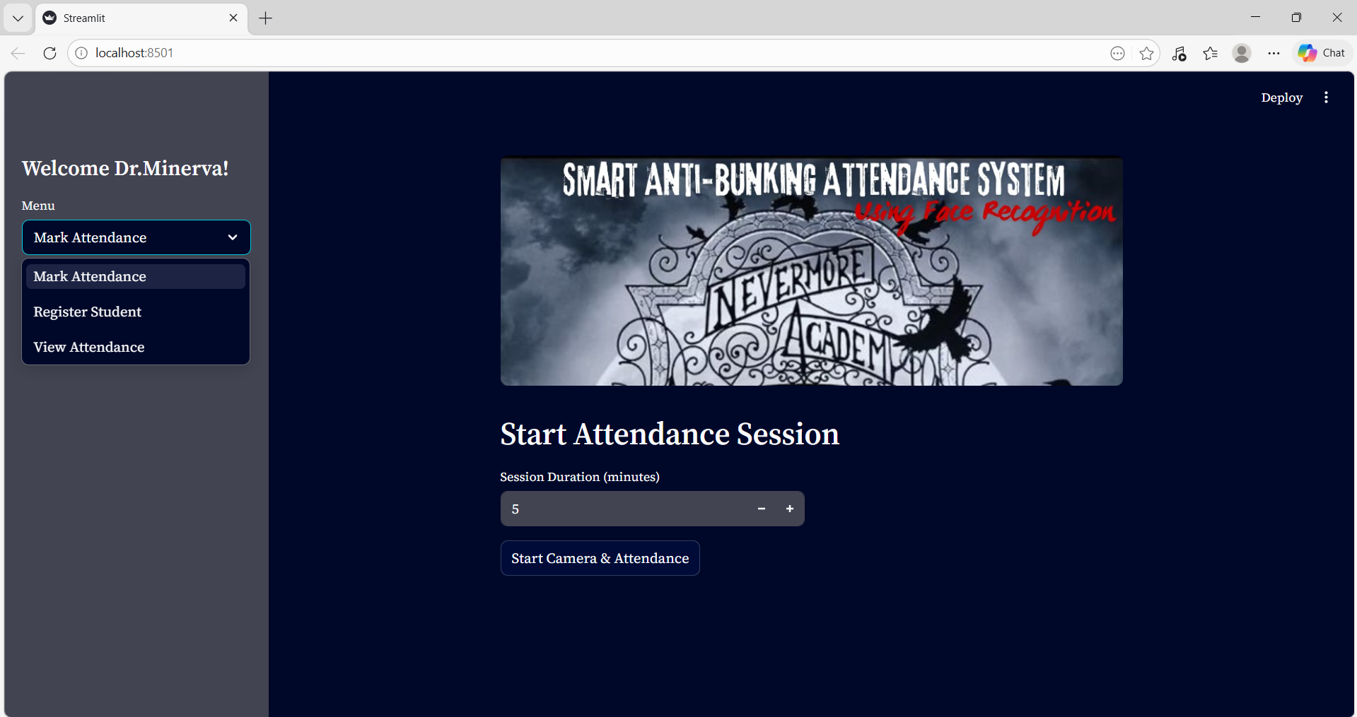
Admin & Faculty Workflows
Register Student Module: Inputs core demographic data, guardian contact numbers, and captures the initial photograph for the 128-d biometric encoding.
Mark Attendance Module: Activates the live webcam, runs real-time computer vision algorithms, and commits "Present" statuses directly to the database.
Automated Communication Trigger: Utilizes pywhatkit to autonomously cross-reference rosters and dispatch WhatsApp absentee alerts immediately after class.
View Attendance & Analytics: Displays an interactive data grid with Excel export utilities for official university audits.

Slide 10
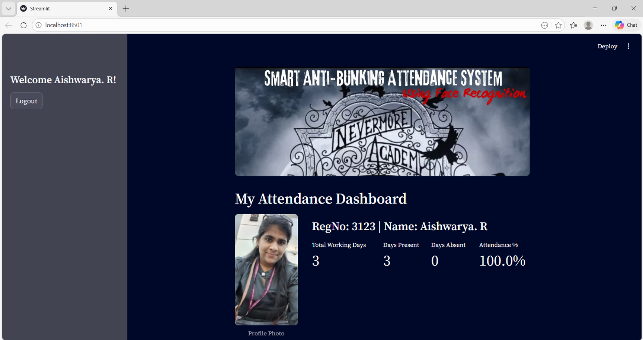
Student Portal
Read-Only Integrity
Designed to maintain absolute data security against unauthorized manipulation by end-users.
PERSONALIZED ATTENDANCE ANALYTICS
REAL-TIME PERCENTAGE TRACKING
WORKING DAYS VS. ABSENTEE RECORDS

Slide 11
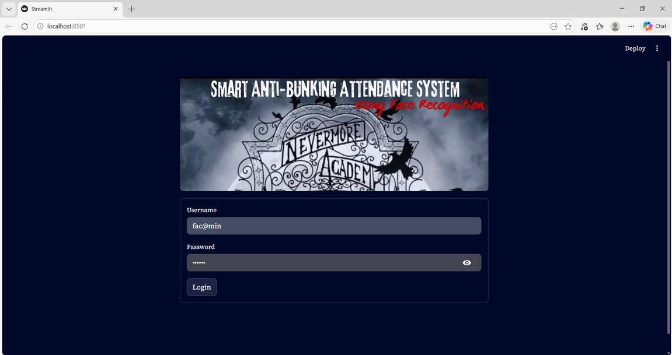

Project Screenshots
LOGIN SCREEN
ADMIN/FACULTY DASHBOARD WITH MARK ATTENDANCE MODULE

Slide 12
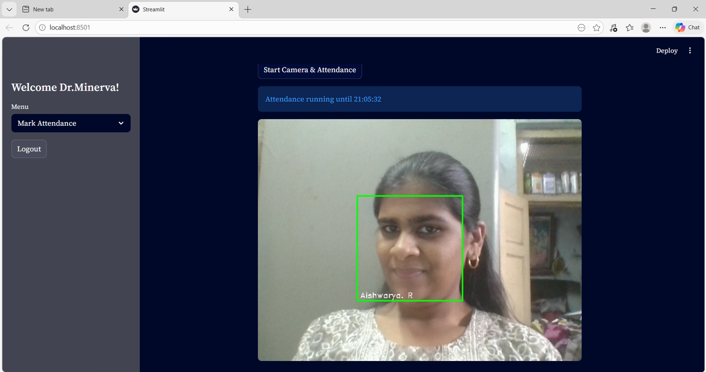
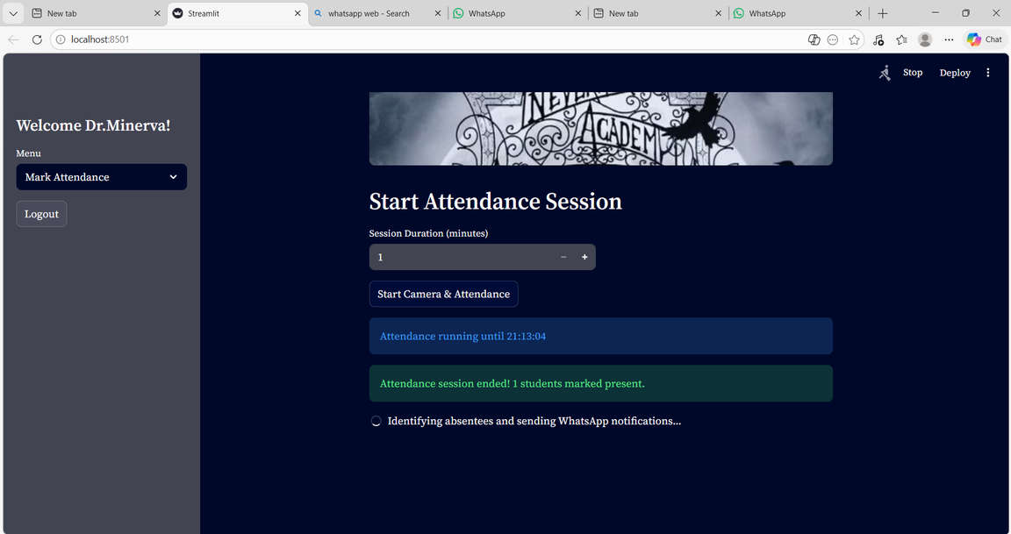
Project Screenshots
LIVE FACE RECOGNITION BASED ATTENDANCE
CLOSURE OF ATTENDANCE

Slide 13
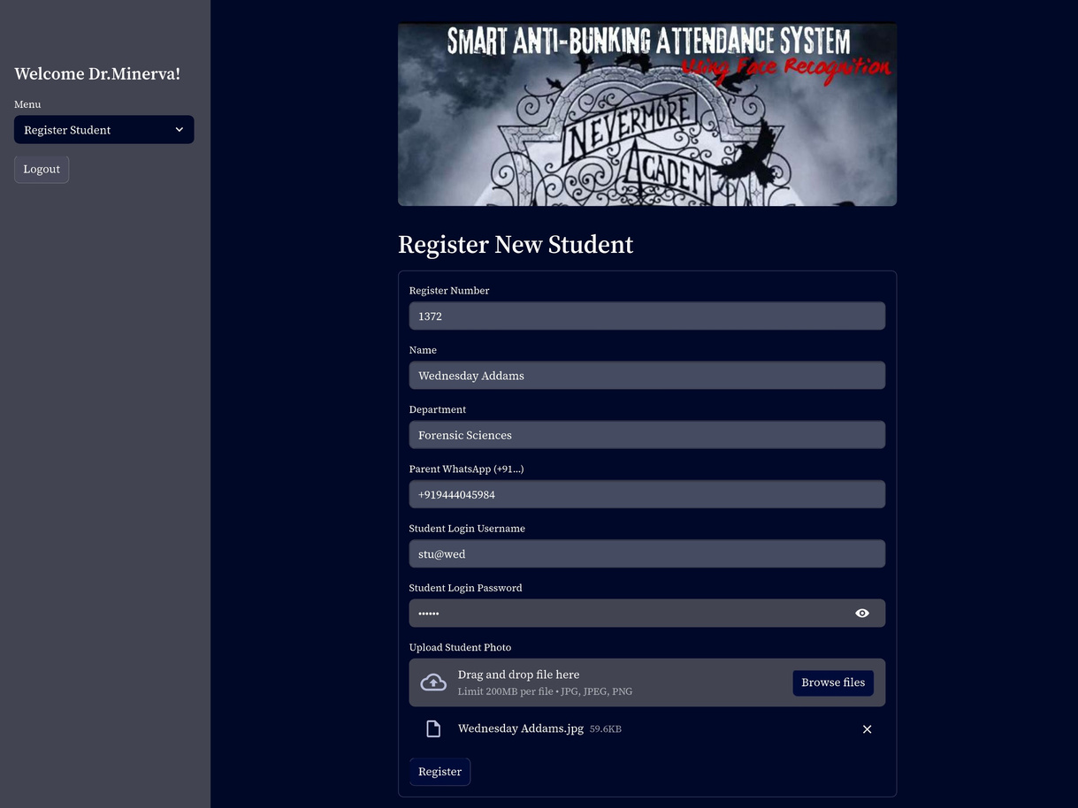
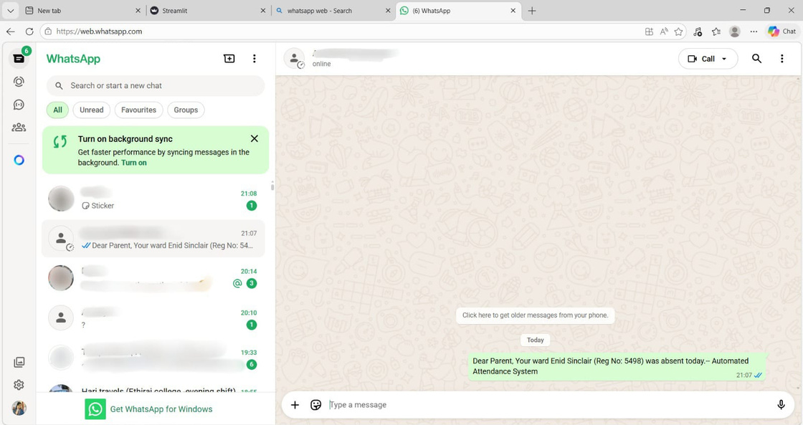
Project Screenshots
AUTOMATED WHATSAPP ALERT
REGISTER STUDENT MODULE

Slide 14
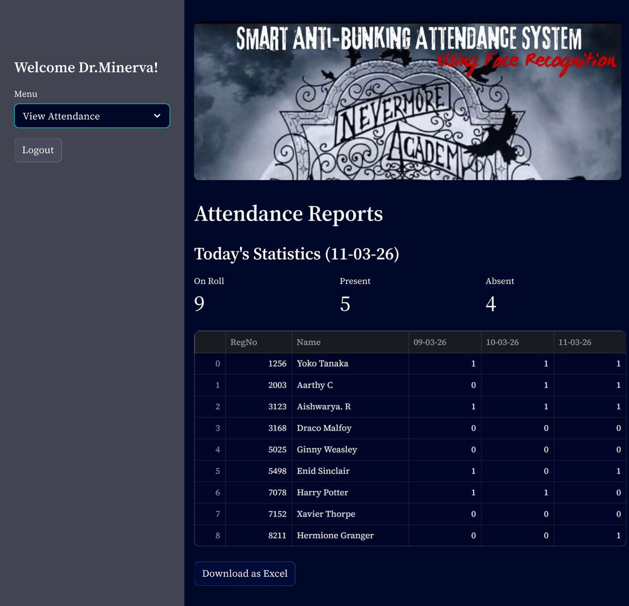
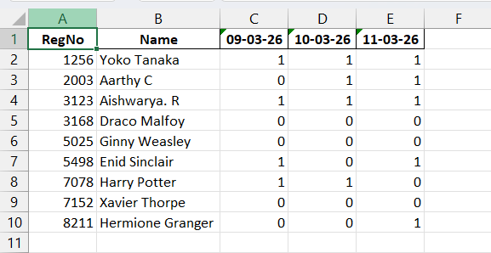
Project Screenshots
VIEW ATTENDANCE MODULE
DOWNLOADED EXCEL REPORT

Slide 15
Project Screenshots
STUDENT DASHBOARD – STUDENT’S PERSONAL ATTENDANCE

Slide 16

Conclusion
KEY IMPACTS
Modernizes Administration: Replaces manual roll calls with automated tracking.
Eliminates Proxies: Biometrically verifies physical presence in real-time.
Enforces Discipline: Transforms passive tracking into active enforcement via instant WhatsApp alerts.
Optimizes Workload: Delivers a secure, scalable, and tamper-proof ecosystem for faculty.

Slide 17



Future Enhancements
ACADEMIC INTEGRATION
Dispatching internal grading results and semester warnings directly via the WhatsApp communication hub.
ANTI-SPOOFING 2.0
Upgrading pipeline to analyze depth data and micro-expressions to neutralize photo/video spoofing attempts.
DYNAMIC SENDER ROTATION
Implementing rotating sender IDs to prevent students from blocking alert numbers on parental devices.

Slide 18
THANK YOU

